Slide 1


Progress Report: 2
Team Charlie
Aakansha Bhatt, Anshu Paudyal, Ingmar Diaz, Michael Foster, Raunaq Chopra, Yang Ye
14th January 2021

Slide 2
Teamwork via zoom
We explain the work done together as a team:
We finalized the hardware we want to purchase.
Worked on setting up the milestones

Slide 3
Aakansha Bhatt
Hardware: I have been trying to research about the charging and discharging of the capacitor and plan on working with Anshu in the same. I am also going to work on displaying the speed of the rover by constructing the speedometer (most probably by using the accelerometer).
Mechanical Design: I have been talking to my team members about the materials we will be ordering and using for making our project. I will be continuing discussions with my team members about the same.
Firmware: <same as above>
Software: I will try to figure out the code for extracting accelerometer data and speed from last quarter’s lab activities.

Slide 4
Anshu Paudyal
This week
Hardware: I have been spending time on doing the power analysis for the solar fuel gauge system, this includes figuring out the charging and discharging time of the capacitor. This will allow us to figure out the capacitance value of the capacitor to use for the project, and also the rover run time.
Mechanical Design: Helped Ingmar and Raun on finding the datasheets for the needed parts to start on the Altium Design of the pcb for the whole system
Firmware: Working on the flowchart for whole system, completed the flowchart for the fuel gauge , but researching on finalizing the firmware systems.
Software: N/A
Transistor Switch can be uses (one is
Off board relays
More this week and Next Week
Complete the flowchart and the power analysis by end of this week working with Ingmar
Start building the rover over the weekend
Starting on solar Charging the capacitor and discharging using the rover beginning of the next week

Slide 5
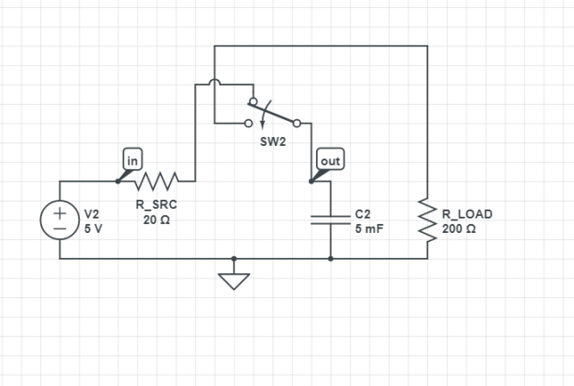
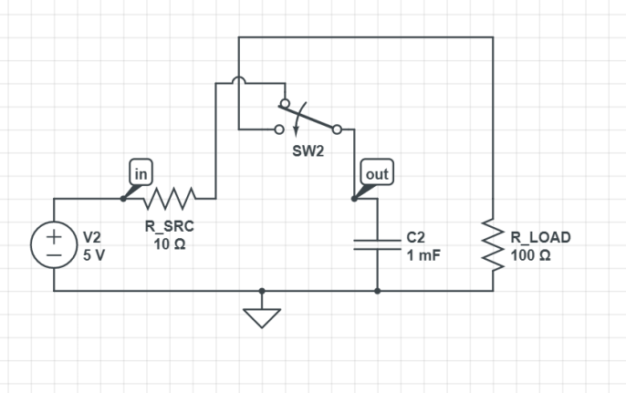
Anshu Paudyal

Slide 6
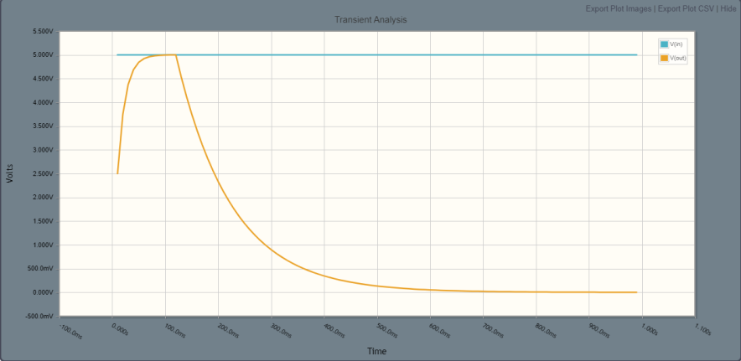
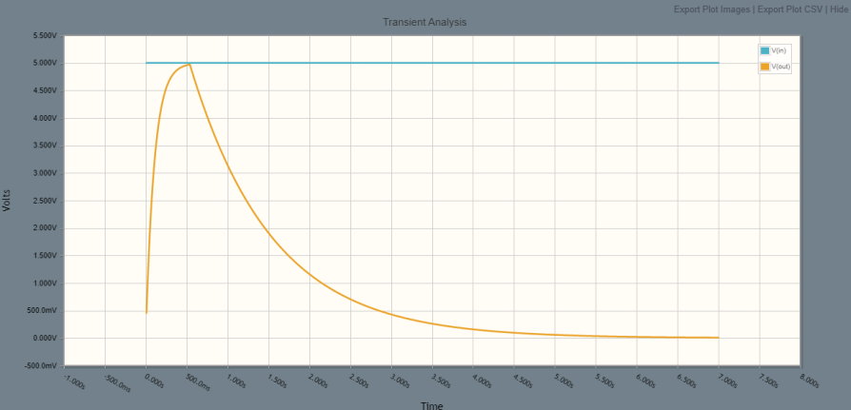
Anshu Paudyal
RL = 100 ohms
RL =200 ohms

Slide 7
Ingmar Diaz
Hardware: Purchased OLED Display and begun researching on how to operate display
Mechanical Design: Will be assisting Anshu with Flow Chart to be completed by this weekend
Firmware: <same as above>
Software: Will mostly likely start programming OLED following week. Will be working with Michael via zoom.

Slide 8
Michael Foster
Hardware: Fuel Gauge for battery/capacitor life.
Mechanical Design: Figuring out the voltage required for the motor in our rover. To charge and also to keep running for as long as possible.
Firmware/Software: We’re going to have a zoom meeting so we can all collaborate on the software and firmware so we’ll all be apart of that part of this project. Me and Ingmar will work on the OLED display.

Slide 9
Raunaq Chopra
Hardware: Mostly spent time looking for datasheets of various parts that are required for the final product. I will be using these in the week to come, along with Ingmar, to work on the Altium designs.
Mechanical Design: I attended the meetings where the products to order were decided and discussed some factors to keep in mind while deciding which parts to order
Firmware and Software: The general consensus is to start working on the software once the hardware and mechanical parts are developed. We will be doing this via zoom meetings as a collective effort.

Slide 10
Yang Ye
Hardware: <Summarize this week's progress and milestones achieved, including team member(s) who contributed to the work. Outline next week's tasks and milestones, including team members who will contribute. You should include figures and use multiple slides if needed.>
Mechanical Design: <same as above>
Firmware: <same as above>
Software: <same as above>

Slide 11
Bill of Materials and Project Budget: Rover Truck and Solar Panels~~$87.42
Project Schedule and Risk Assessment: MILESTONES - Google Docs
Report and Presentation: No date yet.
Marketing and Video: No date yet.
Tips:
1. Be sure to identify tasks and contributions of each team member.
2. Use pictures as much as possible for effective communication.

